Slide 1

Doctor Fee Prediction
The task was to
1) Scrape the all types of doctor’s data of Delhi, Mumbai and Bangalore from online medical consultancy booking site Practo.com using python library and collect information in a table
2) create a machine learning model that can predict the consultation fee for any doctors using their key values such as speciality_of_doctor, degree_type, year_of_experianc, Location, city, score, npv_

Slide 2
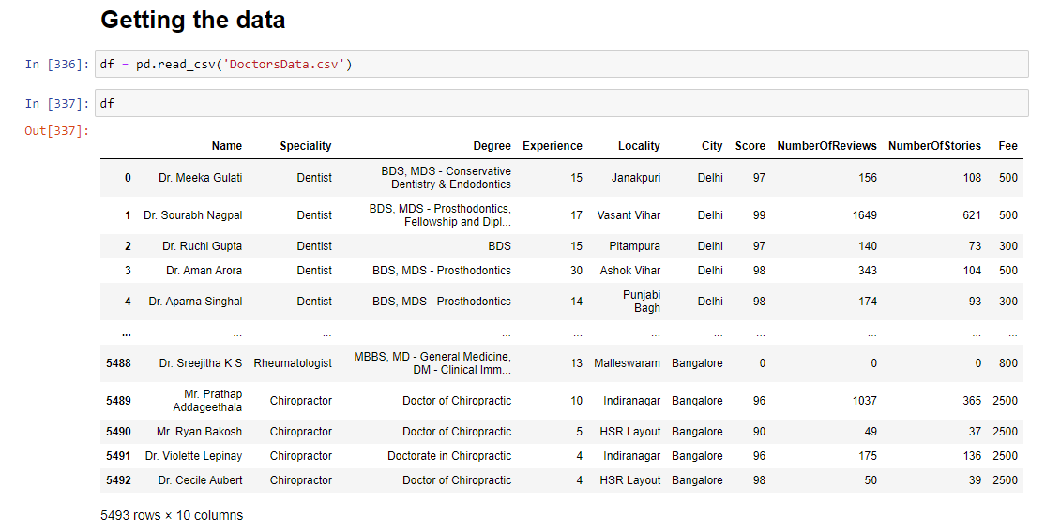
The table was scraped using BeautifulSoup and Selenium
The data was out of three cities that is Delhi, Mumbai and Bangalore

Slide 3
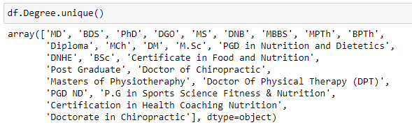
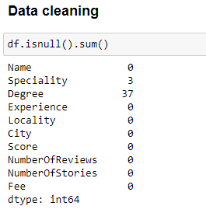
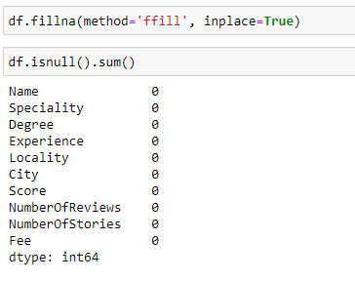
Data Cleaning
Use the method = ‘ffill’ to fill the null and missing values
Grouped the doctors’ degrees into the major degree group

Slide 4
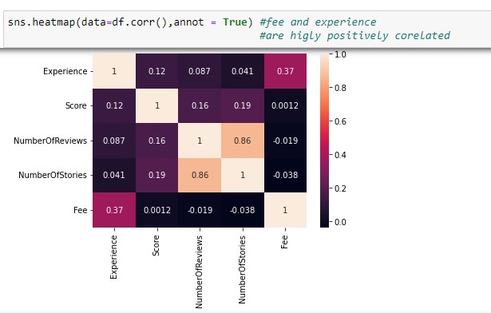
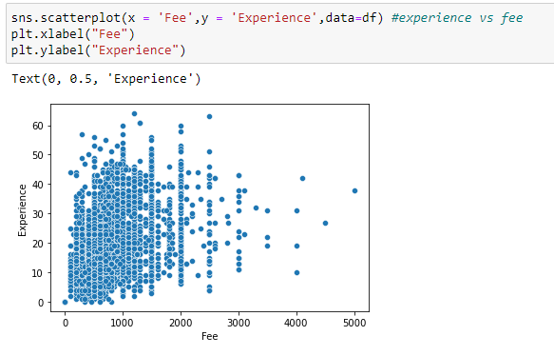
Correlation = fee and experience are highly positively corelated
experience vs fee scatterplot = majority of them have experience around 10 years and fee around 800rs

Slide 5
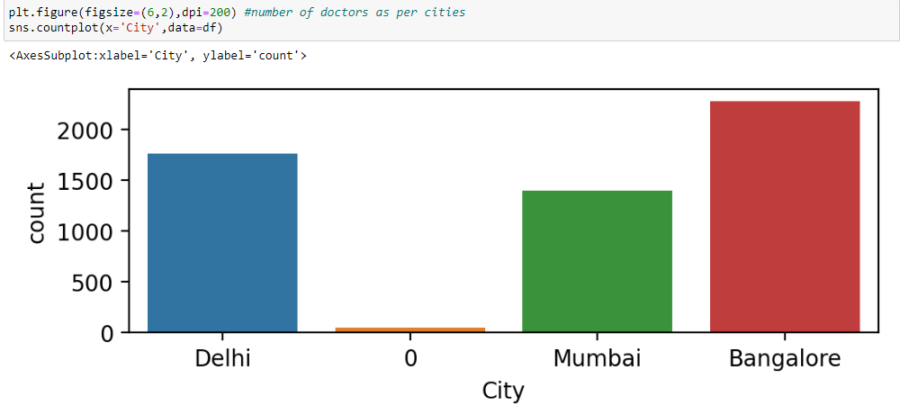
City vs Number of doctors
bar plot = Bangalore has the highest number of doctors followed by Delhi

Slide 6
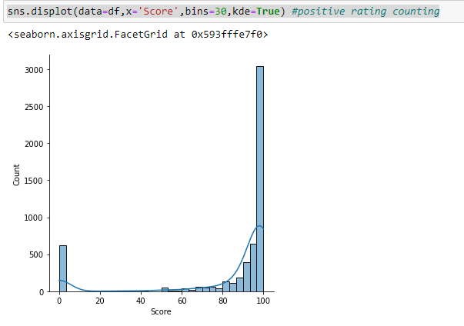
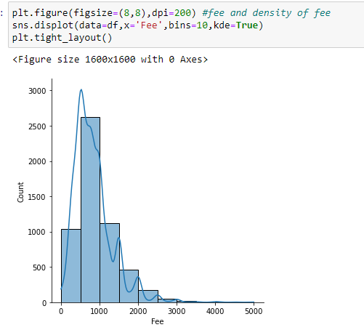
Positive rating Displot = Majority of them have around 95 to 100% positive rate
Density of fee displot = majority of them have 500 to 1000rs consultation fee

Slide 7
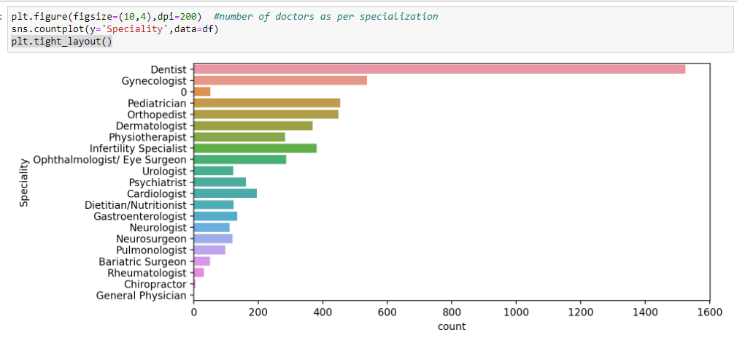
Number of doctor and specialization bar chart = Most of the doctors are dentist

Slide 8
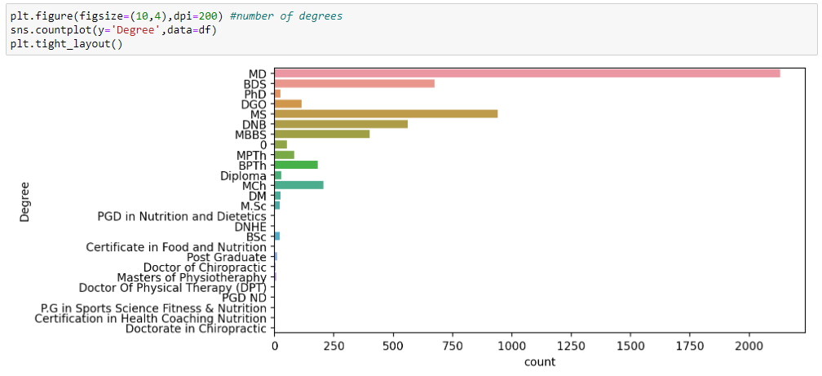
Number of doctor as per degrees bar = majority of them have MD followed by MS

Slide 9
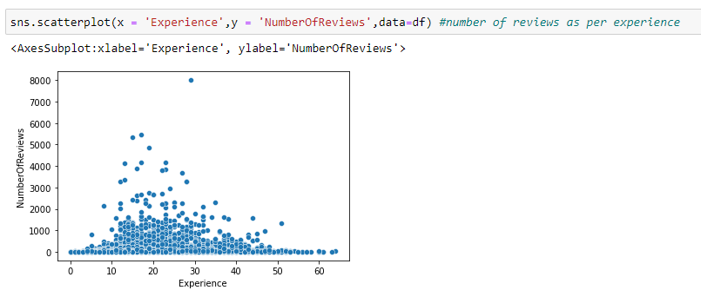
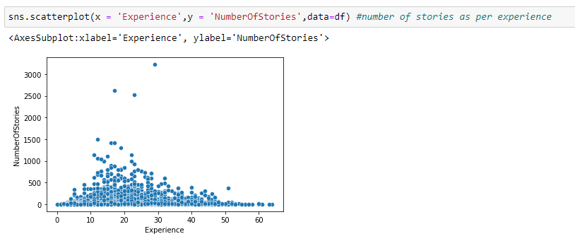
Scatterplot of experience vs number of reviews = most of doctors having experience 15 to 25 years have higher number of review
Scatterplot of experience vs number of stories = most of doctors having experience 15 to 25 years have higher number of review = testimonial

Slide 10
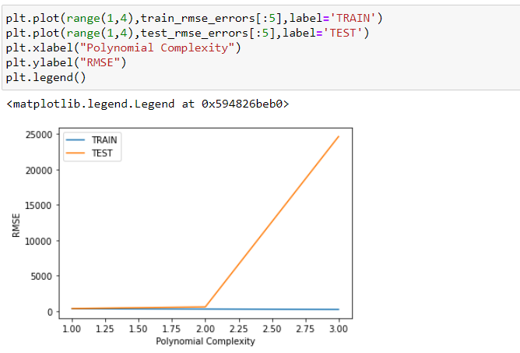
Applying linear regression ML models having different degrees = after the degree 2, train and test error are massive hence considering degree 1 the most apt

Slide 11
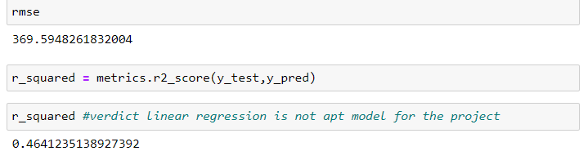
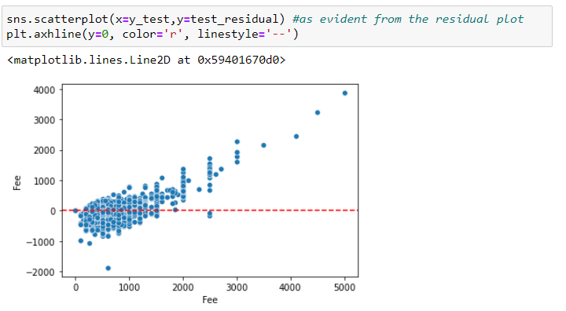
After applying linear regression rmse and r2 are quite bad and in my opinion linear regression is not an apt model for the project
This is also self evident from the scatter plot that scatter should be scattered not concentrated (biased) or normally distributed

